Slide 1
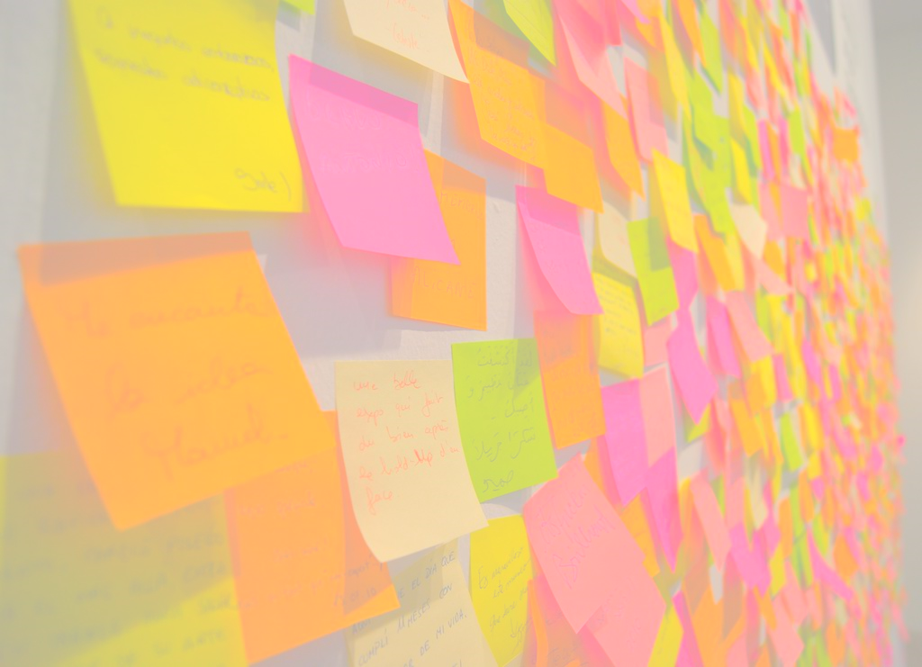
ES 1O1
A practical Introduction

Slide 2
ES: the origin
Defined by FowLer in 2005
“The fundamental idea of Event Sourcing is that of ensuring every change to the state of an application is captured in an event object, and that these event objects are themselves stored in the sequence they were applied for the same lifetime as the application state itself.”

Slide 3
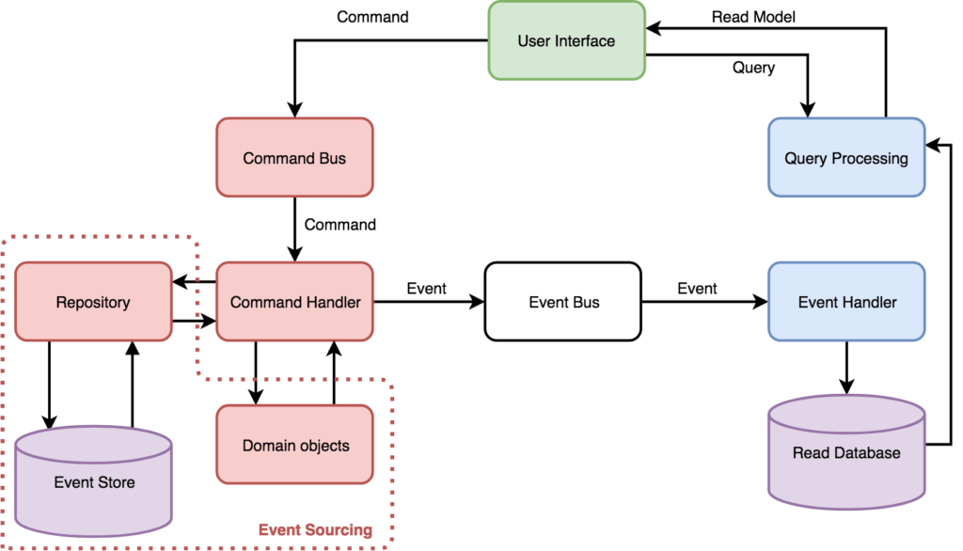
10k ft view
Command bus to send command
Command handler to manage aggregate roots
Event bus to communicate
Event handler to receive the events on aggregates saving
query processor/view

Slide 4

T01: Aggregate root
A DDD aggregate is a cluster of domain objects that can be treated as a single unit.
The aggregate root will expose methods and produces events
Contains everything needed for semantic validation
Is implemented through a list of events
Does not expose any property
Contains all the business logic

Slide 5
T02: command handler
Handle the commands send via a bus and executes the corresponding aggregate root methods
Does the syntactic validation
The commands are the imperative requests to the aggregate root
Retrieves data from other aggregates or services giving it to the aggregate root
Save the aggregate on the event store

Slide 6

T03: Event store
In this new project we extract the logic of the event store in a separate class
Needed to save all events
Can save a list of events taking care of the ordering
Can retrieve a list of events corresponding to a certain aggregate id

Slide 7
T04: “modifying aggregates”
As soon as an aggregate operation is executed, the corresponding events are saved
When we modify an aggregate the aggregate is loaded with the events in the store
Every modification requiring a state change has a suitable “apply” method
All modifications after the aggregate loading will be considered “uncommitted”

Slide 8

T05: Rehydration and event store
Duty of the event store is to rehydrate the aggregate root
This means applying all the aggregate events until the last state
The event store will be able to instantiate the aggregatE

Slide 9
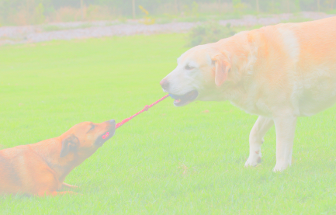
T06: Conflicts
The event store will have as primary key the unique id and the version of the event
Multiple users will access the same aggregate to work on it
Phantom write would be the awful norm

Slide 10
T07: optimistic lock
Now It will be possible to insert events with exactly “event store version+1” value
It’s a kind of optimistic lock
We refactor the code to extract the common aggregate behavior

Slide 11
T08: adding a bus
The ideal communication media is a bus supporting queues and topics
Queue for the commands (unless you have idempotent commands)
Topic for the events
Now we could use the events for something!

Slide 12
T09: Projections
We are now building the “query” side
It’s A kind of “materialized view”
The events will be captured and will be used to store simply readable models
Since they use topics “infinite” views can be built
The events are not checked because, being facts, are always valid
This side can be simple up to the point of having direct SQL calls, rest API and event handler in the same classes

Slide 13
T10: refactoring
The event store should save serialized data in json BUT must know the types!
The serialization process for the events can be extracted to a utility service
Same goes with the identification of the apply methods to rehydrate the aggregate
We will use the factory and singleton patterns for this
Allowing a way to unit test everything

Slide 14

CQRS-04, the red pill
Notes:
Basic: https://docs.particular.net/tutorials/quickstart/
Sagas: https://docs.particular.net/samples/saga/simple/
Delayed delivery: https://docs.particular.net/nservicebus/messaging/delayed-delivery
Rabbit delayed messages: https://www.cloudamqp.com/docs/delayed-messages.html

Slide 15
nservicebus
Real service bus
Can send delayed messages
Can handle sagas
Automatically register the handlers
Can be configured to use several transport (e.g. RabbitMQ, SqlServer etc.)
We use the default di from .NET CORE
Registering the repositories
Configuring the NSB endpoints
Using the “dev” nsb channel
An API will be added to request commands
A BDD - SpecFlow suite is added

Slide 16

References
Eric Evans, Domain-Driven Design, Addison-Wesley, 2003
Jimmy Nilsson, Applying Domain-Driven Design and Patterns, Pearson, 2006
Vaughn Vernon, Implementing Domain Driven Design, Pearson, 2013
NServiceBus, https://particular.net/nservicebus
Martin Folwer, https://martinfowler.com/
Jimmy Bogard, https://jimmybogard.com/

Slide 17
Thank you for your time
Enrico Da Ros:
E-mail: edr@kendar.org
Linkedin: https://www.linkedin.com/in/enricodaros/
Slides and code: https://github.com/kendarorg/CQRS101

